Slide 1
The community of professionals in advanced electronics
Antonio Luque, Vice President for Membership Activities
September 2023

Slide 2
What is IES?
The professional home for advanced electronics

Slide 3


Industrial Electronics
Technologies:
Cybersecurity
Robotics and Mechatronics
Renewable Energy
Healthcare
Smart Grid
Digital Twins
AI Industrial Processes
Industry 5.0
Our
Vision
IES enables members’
careers by building communities worldwide and advances global prosperity through technological innovation and dissemination of knowledge.
3
www.ieee-ies.org
www.ieee-ies.org

Slide 4
The IEEE Industrial Electronics Society
One of the oldest, most international, and most successful Societies in IEEE
Top-ranked journals
and conferences
Wide variety in
technical topics
More than
10,000 members
IES promotes the engineering process of creating, developing, integrating, sharing, and applying knowledge about electro- and information technologies and sciences for the benefit of humanity and the profession.
FOI: computer control systems, robotics, factory communications and automation, flexible manufacturing, data acquisition and signal processing, vision systems, and power electronics. Applied to industrial and manufacturing processes

Slide 5


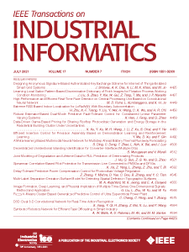
Publications
IEEE Transactions on Industrial Electronics
Industrial Electronics Magazine
IEEE Transactions on Industrial Informatics
70-year history
Impact factor of 8.236 in 2020
(19th out of 319 journals in EE)
#2 IEEE journal in Eigenfactor score (after IEEE Access)
Mailed to all members
In the top-10 of EE journals by Article Influence Score
(IF 8.360)
Ranked #3 in JCR Automation and Control Systems
Ranked #4 in Computer Science
5
www.ieee-ies.org
www.ieee-ies.org

Slide 6
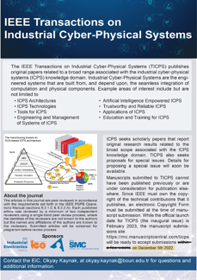
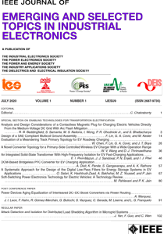

Publications
IEEE Transactions on Industrial Cyber-Physical Systems
Open Journal of the IES - OJIES
JESTIE
Launched in 2023 on the exciting field of ICPS (Cyber-Physical Systems)
They are engineered systems built from seamless integration of physical components.
Publishes papers on special and emerging topics and new trends.
Focuses on information-intensive, knowledge-based automation
Covers energy, mobility, health, home/building, and other infrastructure eco-systems.
6
www.ieee-ies.org
www.ieee-ies.org

Slide 7



Conferences
ICIT 2024 Bristol, UK
IEEE IES hosts three flagship conferences in a rotating scheme
Conferences on specific topics: industrial informatics, factory automation, motion control, renewable energies, electrical machines, etc.
More than 20 yearly conferences and workshops all over the world.
ISIE 2024 Ulsan, Korea
IECON 2024 Chicago, IL, USA
7
www.ieee-ies.org
www.ieee-ies.org

Slide 8

Resources for Members
IES is a worldwide and transversal society. In addition to belonging to a community of more than 10,000 professionals and students, our members can also participate in smaller communities, tailored to their interests.
Technical Committees on every topic related to Industrial Electronics
Chapters uniting members in close proximity, where local activities
and interaction happen
Student Branch Chapters, self-organized units for students in one college or university
Young Professionals community, organizing meet-ups and forums at most IES conferences and other events
Women in Industrial Electronics promoting women and advancing diverse talents
Groups participating in humanitarian projects like IEEE Smart Village
All these communities are managed by volunteer members of the Society and are open to any IES member.
8
www.ieee-ies.org
www.ieee-ies.org

Slide 9
IES membership allows you to
Give back to society
The IES Industry Forums puts industry executives in contact with researchers and innovators enabling interaction and sharing of industry trends and needs. IES empowers modern industry to shape the future and create a sustainable societal impact.
Membership in IES allows you to participate in meaningful humanitarian technology activities that address societal challenges such as access to electricity or climate change in a responsible and effective way.
Education and STEM promotion is at the core of IES activities, and educational resources, courses, webinars, and distinguished lectures are available to members, either in person in different parts of the world, or with online access.
Join our communities
Access knowledge and networking
Get the IEEE Industrial Electronics Magazine in print and online as well as access to the following:
• IEEE Transactions on Industrial Electronics
• IEEE Transactions on Industrial Informatics
• IEEE Journal of Emerging and Selected Topics in Industrial Electronics
• IEEE Open Journal of the Industrial Electronics Society (OJ-IES)
• IEEE Transactions on Industrial Cyber-Physical Systems
• Networking opportunities with global technical experts
• Industry activities and/or conferences
• Discounted access to over 30 conferences annually
• Support for students and recent graduates

Slide 10

The IEEE Industrial Electronics Society
Governing Bodies
Administrative Committee (AdCom)
Officers
Past Presidents
Senior and Life member delegates
Cluster delegates
Members-at-large
Officers
President
President-Elect
7 Vice Presidents (TA, MA, IA, CA, WA, PA, PD)
Secretary
Treasurer
10
www.ieee-ies.org
www.ieee-ies.org

Slide 11
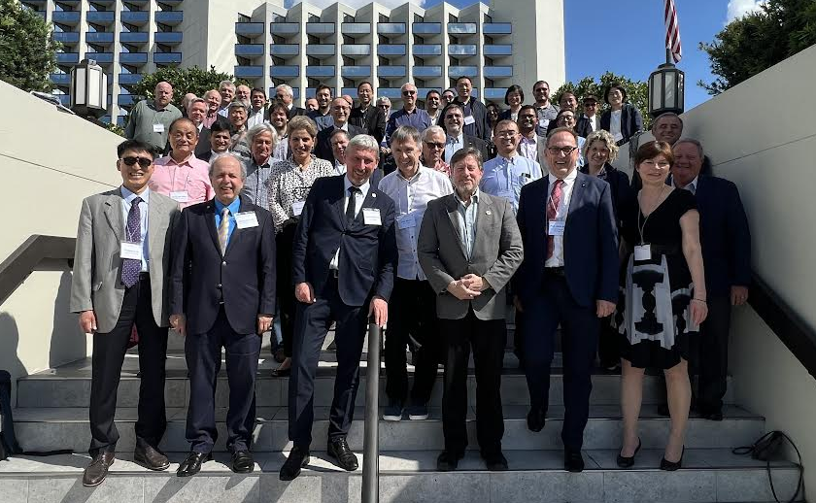
The IEEE Industrial Electronics Society
Governing Bodies
11
www.ieee-ies.org
www.ieee-ies.org

Slide 12
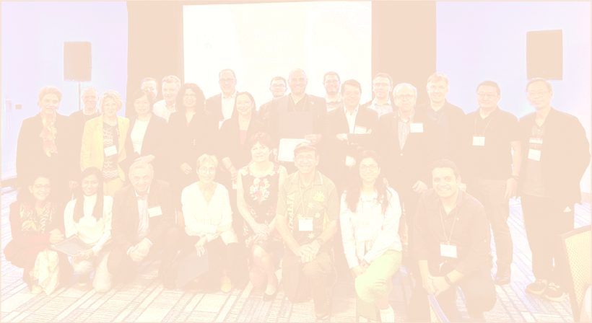
Volunteer for IES
Technical Committees
Publications
Conferences
Students
Chapters
Humanitarian Technology
Whether you are a student, a researcher, an industry practitioner or an entrepreneur, you can contribute to IES in a variety of ways.
Governance
12
www.ieee-ies.org
www.ieee-ies.org

Slide 13
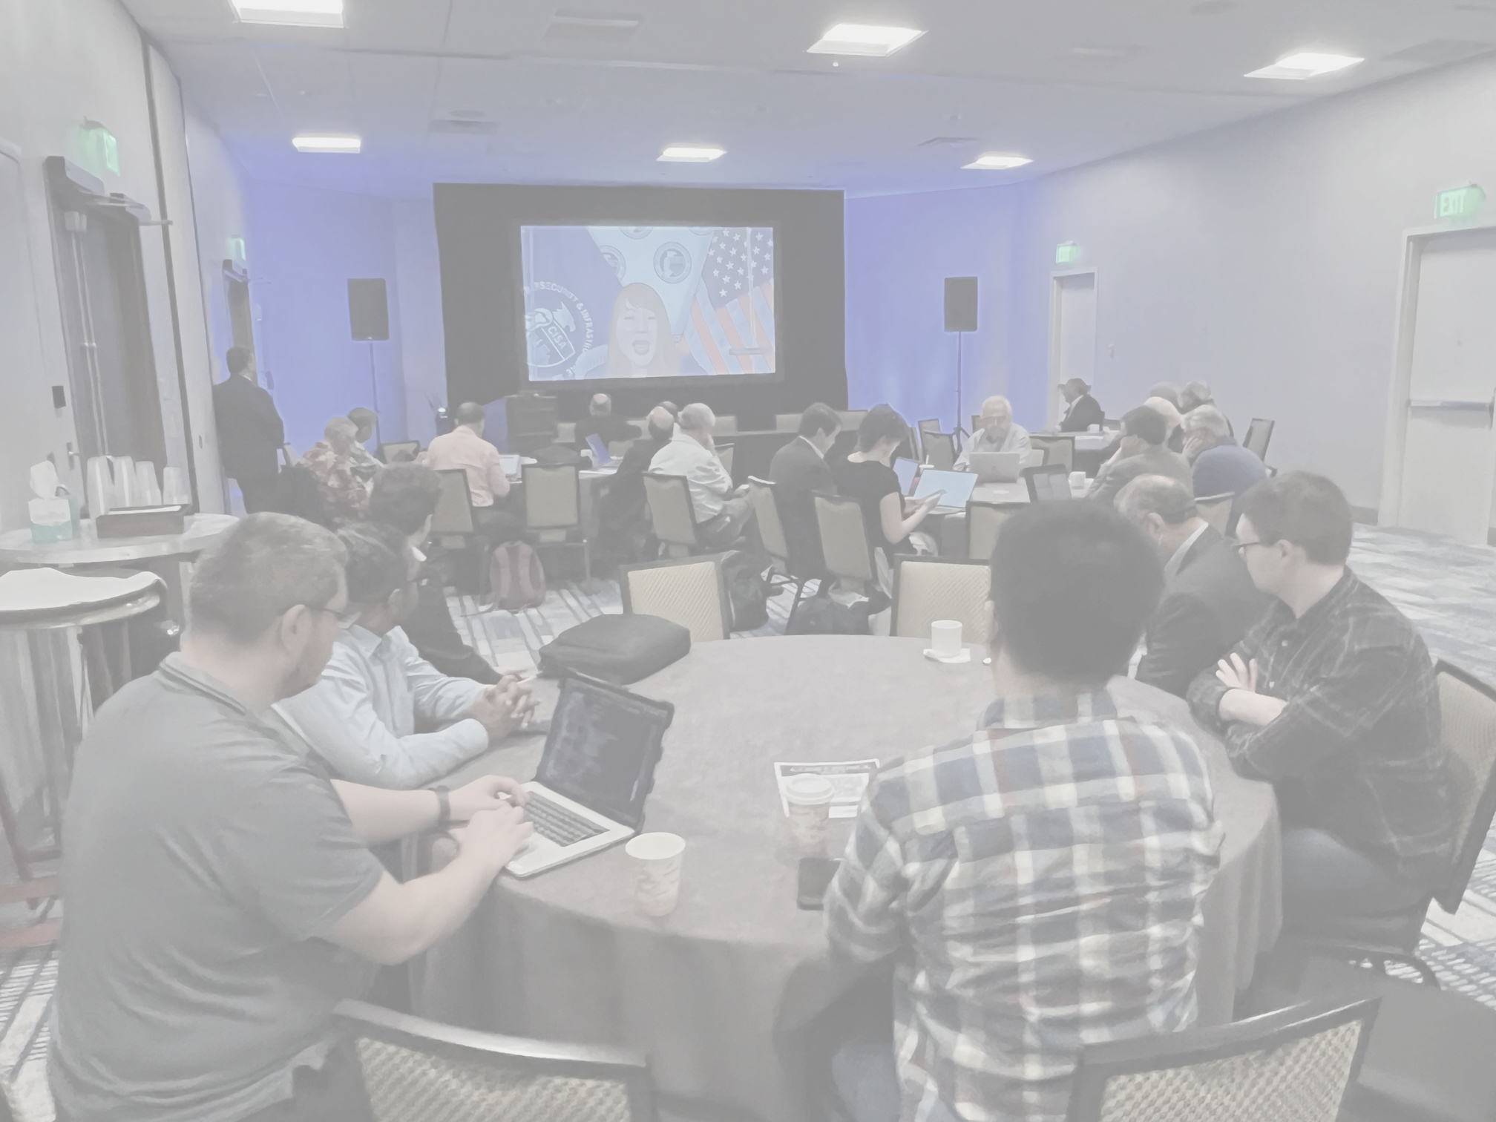

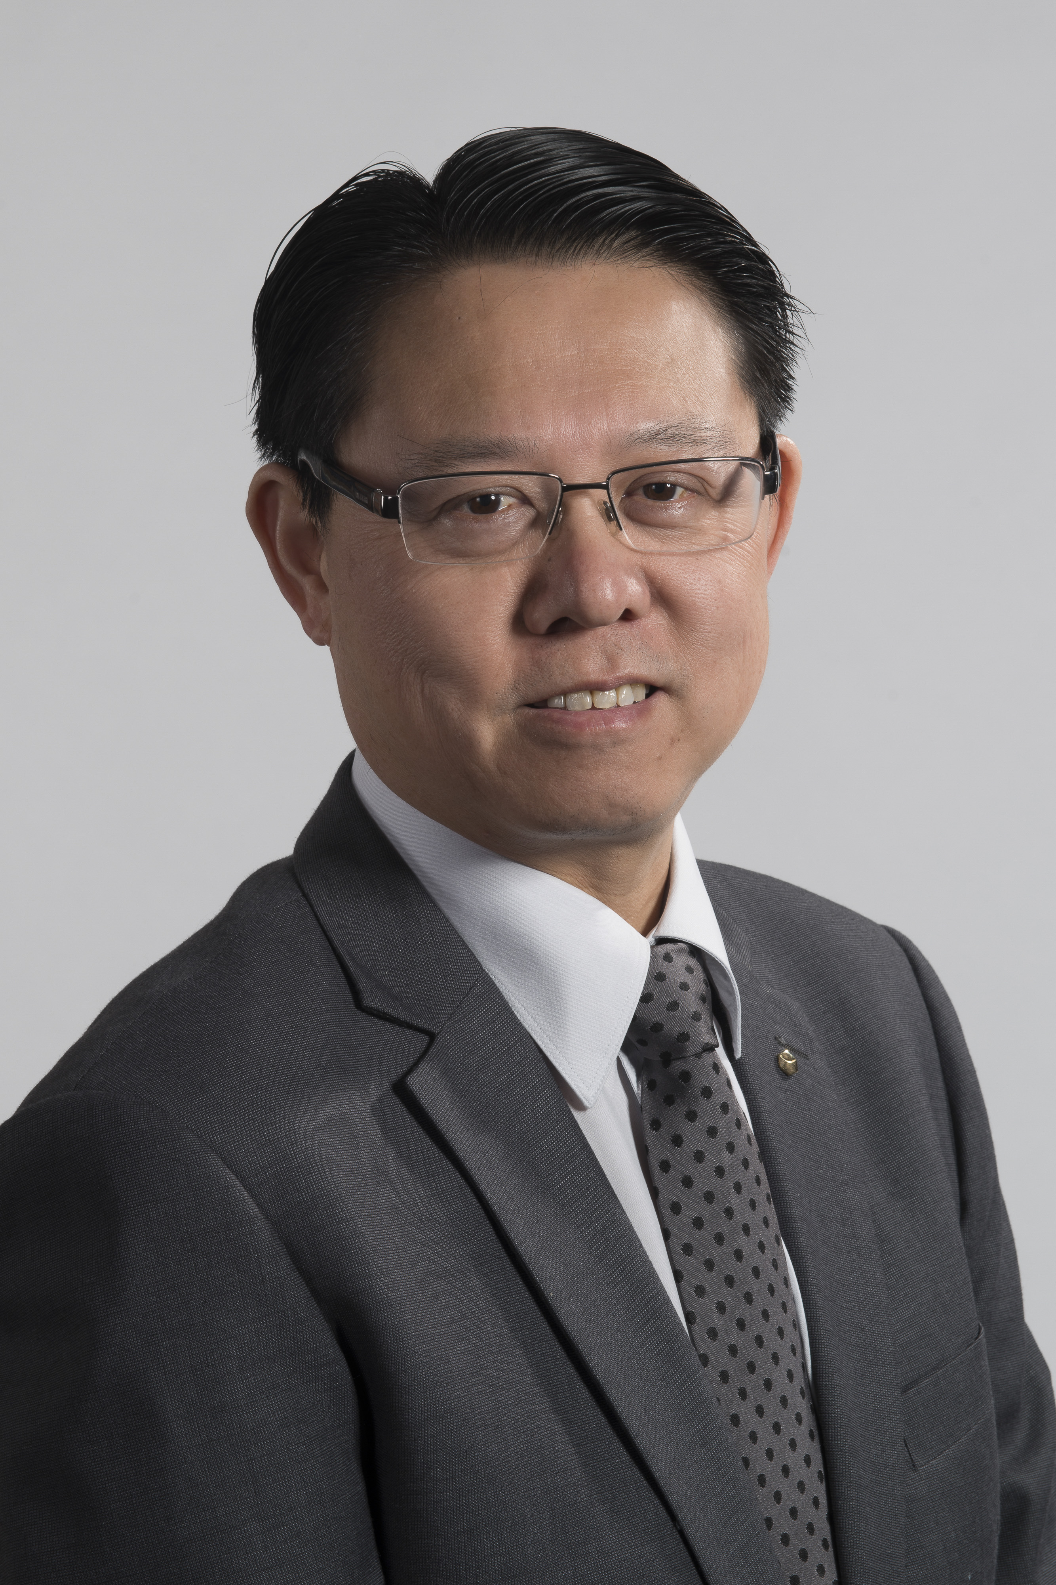
“IES helped me finance the
travel to attend IECON
conference and gave me the
opportunity to interact with
professionals who motivated
me to continue my PhD for
the advancement of science,
technology, and fellowship.”
Carolina Beckmann, PhD student
“IES is home for innovation, harnessing the power of AI and cutting-edge technologies to tackle critical challenges within industrial systems and processes.”
Xinghuo Yu, IES Past President

Slide 14


Thank you!
Antonio Luque
Vice President for Membership Activities
aluque@ieee.org
Join IES Today!
www.ieee-ies.org/membership
x.com/ieee_ies
facebook.com/IndustrialElectronicsSociety
linkedin.com/groups/3124640
youtube.com/@ieee-ies
14
www.ieee-ies.org
www.ieee-ies.org

